Slide 1

Analysis of multimodal LLMs in Visualization Tasks
Under the supervision of: Prof. Sougata Mukherjea
ELD881
Major Project
Presented by: Saadiq Rauf Khan (2022EET2101)
& Vinit Raman Chandak (2022EET2109)

Slide 2
Abstract & Introduction
Scientific figures compactly summarize valuable information. They depict patterns like trends, rates, and proportions, and enable humans to understand these concepts intuitively at a glance.
Machine understanding of this structured visual information could assist human analysts in extracting knowledge/information from the vast documentation produced by modern science.
Besides immediate applications, machine understanding of plots is interesting from an artificial intelligence perspective, as most existing approaches simply revert to reconstructing the source data, thereby inverting the visualization pipeline.

Slide 3
Abstract & Introduction
Mathematics exams, such as the Graduate Records Examinations (GREs), often include questions regarding relationships between plot elements of a figure. When solving these exam questions, humans do not always build a table of coordinates for all data points, but often judge by visual intuition.
In this project we aim to evaluate and analyze the performance of multimodal LLMs for visualization tasks.
Multimodal LLMs refers to the LLM-based models with the ability to receive and reason with multimodal information, specifically images in our case.

Slide 4
Literature Survey
1. DVQA: Understanding Data Visualizations via Question Answering ^{[1]}
This paper introduces the DVQA dataset, which challenges existing algorithms to understand bar charts through a question-answering framework.
The paper highlights the limitations of current visual question answering (VQA) algorithms in parsing bar charts due to their inability to handle variations in appearance.
Solving DVQA will enable systems that can be utilized to intelligently query massive repositories of human-generated data, which would be an enormous aid to scientists and businesses.
2. MME: A Comprehensive Evaluation Benchmark for Multimodal Large Language Models ^{[2]}
This paper introduces the MME (Multimodal LLM Evaluation) benchmark, which aims to provide a comprehensive evaluation of Multimodal LLMs to address the lack of a standardized evaluation method for MLLMs.
The benchmark includes 14 subtasks covering various aspects such as existence, count, position, colour recognition, common-sense reasoning, numerical calculation, text translation, and code reasoning.

Slide 5
The MME benchmark evaluates both perception and cognition abilities across the 14 subtasks, measuring the performance of 30 advanced MLLMs.
The responses of MLLMs to the instructions are quantitatively analyzed based on "yes" or "no" outputs, enabling accurate and objective assessment.
3. A Challenger to GPT-4V? Early Explorations of Gemini in Visual Expertise^{[3]}
This paper present a preliminary exploration of Gemini Pro’s visual understanding proficiency, which comprehensively covers four domains: fundamental perception, advanced cognition, challenging vision tasks, and various expert capacities.
It compares Gemini Pro with the state-of-the-art GPT-4V to evaluate its upper limits, along with the latest open-sourced MLLM, Sphinx, which reveals the gap between manual efforts and black-box systems.
Both Gemini and GPT-4V exhibit suboptimal performance in the position recognition sub-task while the performance of Sphinx on perception is on par or even exceeds that of Gemini and GPT-4V. However, Sphinx lags considerably on the cognition sub-tasks, including common-sense reasoning, numerical calculation, text translation, and code reasoning.

Slide 6

Dataset
The dataset utilized for this study is accessible online and is referred as the FigureQA dataset.^{[4]}
It is an annotated figure dataset for visual reasoning comprising of over one million question-answer pairs grounded in over 100,000 images
The images are synthetic, scientific-style figures from five classes: line plots, dot-line plots, vertical and horizontal bar graphs, and pie charts. And they also contain common plot elements such as axes, gridlines, labels, and legends
Question-answer pairs are generated for each figure from its numerical source data according to predefined templates.
In total 15 questions types that compare quantitative attributes of two plot elements or one plot element versus all others.
Questions examine properties like the maximum, minimum, median, roughness, and greater than/less than relationships. All are posed as a binary choice between yes and no.

Slide 7
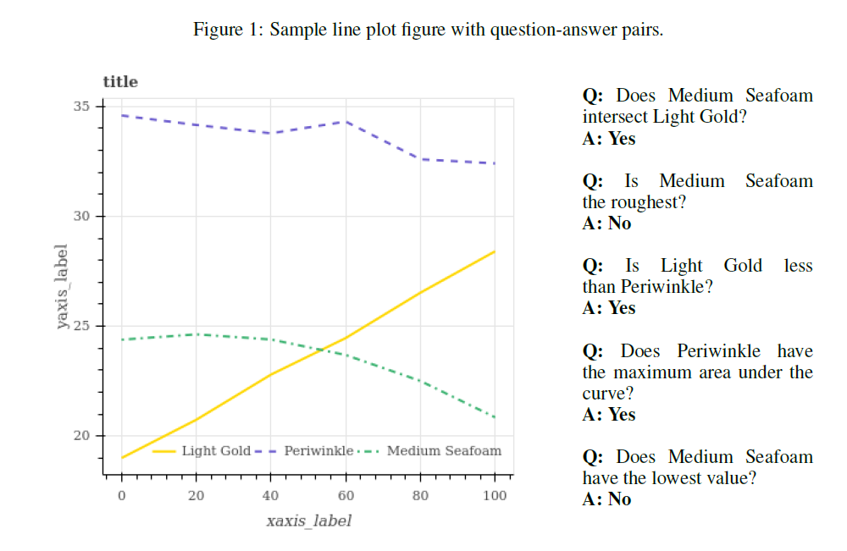

Slide 8
Current Scenario of Multimodal LLMs
Model Name | API | API link | Demo's
BLIP - 2 | No | - | https://github.com/NielsRogge/Transformers-Tutorials/tree/master/BLIP-2
mPLUG - OWL | Yes - Free, limit? | https://replicate.com/joehoover/mplug-owl | -
InstructBLIP | No | - | -
VisualGLM - 6B | No | - | -
GPT 4V | Yes - Paid, 0.64rs per image | https://platform.openai.com/docs/overview | -
git-large | No |  | https://huggingface.co/microsoft/git-large
interLM - Xcomposor2 | No | - | -
LLaVA | Yes - Free, limit? | https://llava.hliu.cc/?view=api | -
Octopus | No | - | -
Otter/OtterHD | No | - | -
Owen VL/Qwen VL Max | Yes - Free, limit? | https://huggingface.co/spaces/Qwen/Qwen-VL-Max | -
SPHINX | Yes - Free, limit? | http://imagebind-llm.opengvlab.com/? | -
Skywork - MM | No | - | -

Slide 9
Current Scenario of Multimodal LLMs
Model Name | API | API link | Demo's
VPGTrans | No | - | -
WeMM - No chat version yet | No | - | -
BLIVA | No | - | https://huggingface.co/spaces/mlpc-lab/BLIVA
InfMLLM | No | - | Yes - Local
LLaMA - AdaptarV2 | No | - | https://huggingface.co/spaces/csuhan/LLaMA-Adapter
MiniGPT-4 | Yes | https://huggingface.co/spaces/Vision-CAIR/minigpt4 | -
mPLUG - OWL2 | Yes | https://huggingface.co/spaces/MAGAer13/mPLUG-Owl2 | -
Gemini Pro Vision | Yes | https://cloud.google.com/vertex-ai/generative-ai/docs/model-reference/gemini#gemini-pro-vision | -
Gemini Advanced | No | - | https://gemini.google.com/app

Slide 10
Future Work
1.
For all the LLMs for which we have an API, write python scripts that serve static images to the LLMs along with the question & answer pairs and check for correctness.
Determining if the performance of the models can be improved using prompt engineering. If yes, to what extent?
We noticed that, sometimes, the model has no understanding of the underlying graph/chart but still gives the correct answer. This is because the answers are binary in nature. Need to figure out a way to test for this.
3.
2.

Slide 11
Future Work
4.
See if we can utilize LLMs for creating visualizations of various types of data like tables and graphs.

Slide 12

References
[1] Kafle, K., Price, B., Cohen, S., & Kanan, C. (2018). Dvqa: Understanding data visualizations via question answering. In Proceedings of the IEEE conference on computer vision and pattern recognition (pp. 5648-5656).
[2] Fu, C., Chen, P., Shen, Y., Qin, Y., Zhang, M., Lin, X., ... & Ji, R. (2023). Mme: A comprehensive evaluation benchmark for multimodal large language models. arXiv preprint arXiv:2306.13394.
[3] Fu, C., Zhang, R., Lin, H., Wang, Z., Gao, T., Luo, Y., ... & Ji, R. (2023). A challenger to gpt-4v? early explorations of gemini in visual expertise. arXiv preprint arXiv:2312.12436.
[4] Ebrahimi Kahou, S., Michalski, V., Atkinson, A., Kadar, A., Trischler, A., and Bengio, Y., “FigureQA: An Annotated Figure Dataset for Visual Reasoning”, arXiv e-prints, 2017. doi:10.48550/arXiv.1710.07300.

Slide 13
Thank you

